Slide 1
Instagram Performance Analytics for Sugar Cosmetics
BY:
SRIMATHI K

Slide 2
Problem Statement
Analyze Sugar Cosmetics' Instagram performance and design an interactive Tableau dashboard to recommend strategic social media decisions.

Slide 3
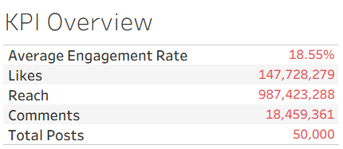
TASK 1
Insight
The account shows a strong average engagement rate (~18.5%), indicating content relevance.
High reach confirms the algorithm is distributing content effectively.
Engagement volume is skewed toward likes rather than comments, indicating low conversational engagement.
Business Interpretation: The account is visible and engaging, but not fully driving community interaction.
Action: Shift from passive content to interactive formats (polls, questions, CTA-driven captions).

Slide 4
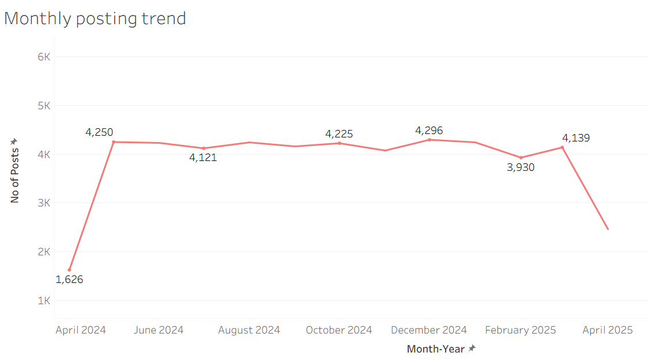
TASK 2
Insight
Posting frequency stabilized at a high level after early 2024.
Months with posting dips show potential engagement risk
Business Interpretation: Consistency directly supports reach and engagement stability.
Action: Implement a monthly content calendar with minimum posting benchmarks.

Slide 5
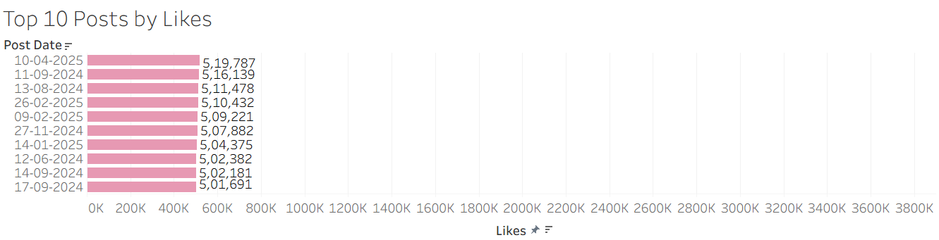
TASK 3
Insight
High-like posts are often visually appealing or campaign-driven.
These posts maximize reach, but do not always have high engagement rates.
Business Interpretation: Likes measure popularity, not depth of connection.
Action: Use these posts for brand awareness, not engagement benchmarking.

Slide 6
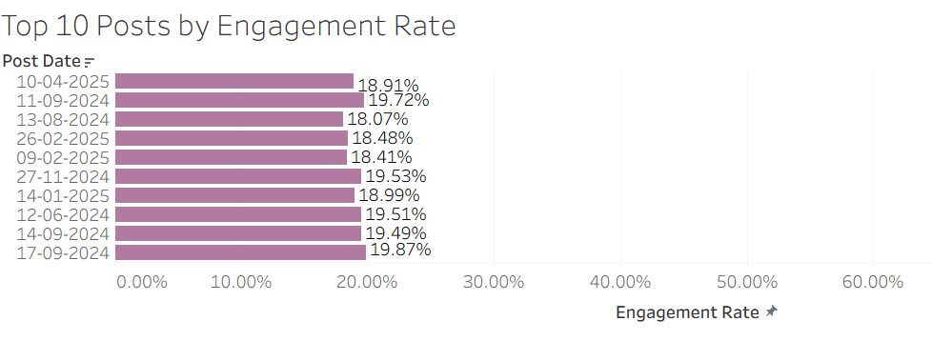
TASK 4
Insight
Several posts with moderate likes show exceptionally high engagement rates.
These posts resonate deeply with a specific audience segment.
Business Interpretation: These are high-quality content assets.
Action:
Repurpose these posts into:
Reels Story highlights Paid promotion experiments

Slide 7
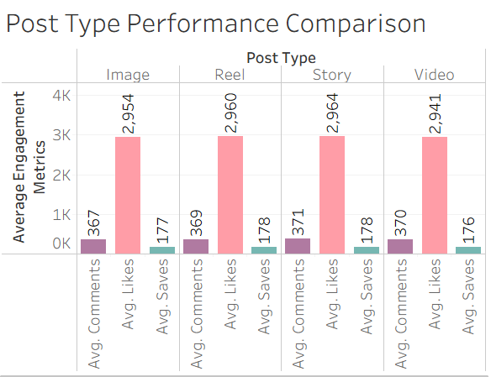
TASK 5
Insight
Reels and Stories outperform Images in engagement.
Images are consistent but less interactive.
Business Interpretation
Instagram’s algorithm favors short-form and immersive formats.
Action
Prioritize Reels for product launches and Stories for daily engagement.

Slide 8
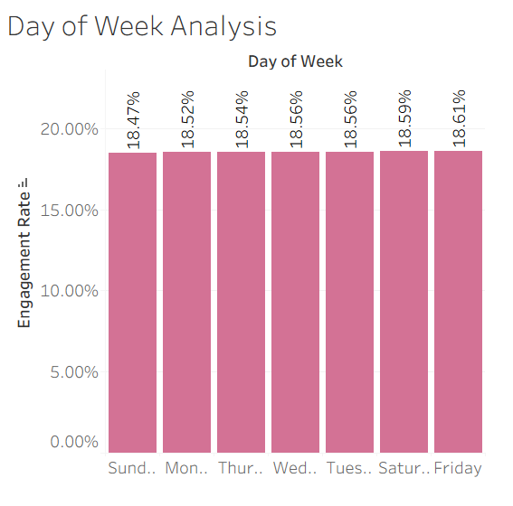
TASK 6
Insight
Engagement peaks on Friday and Saturday.
Weekdays perform steadily but lower.
Business Interpretation
Audience is more active and receptive on weekends.
Action
Schedule:
Campaign posts → weekends
Informational posts → weekdays

Slide 9
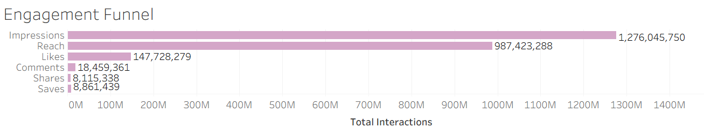
TASK 7
Insight
Significant drop from Reach → Likes
Saves outperform comments.
Business Interpretation: Content is valuable but lacks strong initial hooks and conversation starters.
Action: Improve first 3 seconds of reels, Add direct Hooks like “Save for later” or “Comment your shade”

Slide 10
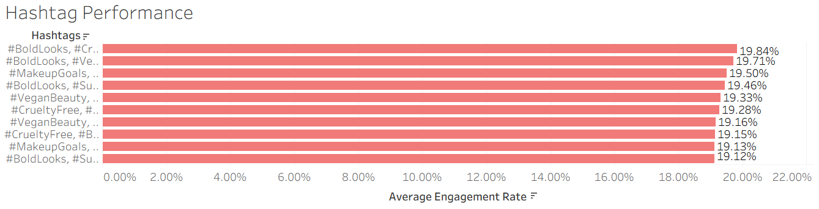
TASK - 8
Insight
Hashtags around Vegan, Cruelty-Free, Makeup Goals perform best. Ethical beauty messaging consistently drives engagement.
Business Interpretation: Audience strongly aligns with brand values.
Action: Create recurring campaigns around ethical beauty and sustainability themes.

Slide 11
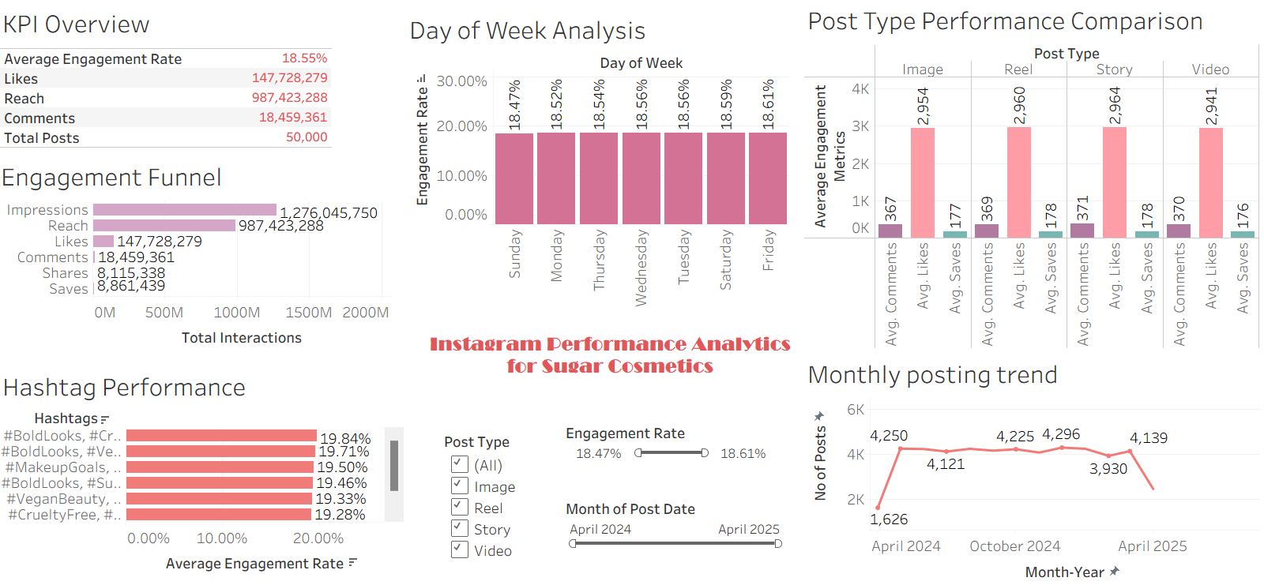
TASK - 9

Slide 12
OVERALL INSIGHTS
Strong overall performance with ~18.5% engagement, driven mainly by Reels and Stories, showing short-form content works best.
Weekend posting (Friday–Sunday) consistently delivers higher engagement, making it ideal for campaigns and launches.
Ethical beauty hashtags (Vegan, Cruelty-Free, Makeup) outperform others, indicating strong audience alignment with brand values.
Engagement drop from Reach to Likes highlights the need for stronger hooks and clearer call-to-actions.
Consistent posting and CTA-driven content (Reels, interactive Stories, UGC campaigns) can improve engagement and follower growth.

